Slide 1
Settings UI & Preferences Framework
Android Developer Fundamentals
Lesson 9
This work is licensed under a Creative Commons Attribution-NonCommercial 4.0 International License

Slide 2
9.2 Settings UI
This work is licensed under a Creative Commons Attribution-NonCommercial 4.0 International License

Slide 3
Contents
What are settings?
Setting screens
Implement settings
Default settings
Save and retrieve settings
Respond to changes in settings
Summaries for settings
SettingsActivity template

Slide 4
Settings

Slide 5
What are app settings?
Users can set features and behaviors of app Examples:
Home location, defaults units of measurement
Notification behavior for specific app
For values that change infrequently and are relevant to most users
If values change often, use options menu or nav drawer

Slide 6
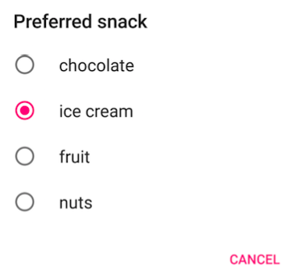
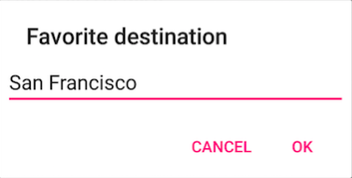

Example settings

Slide 7
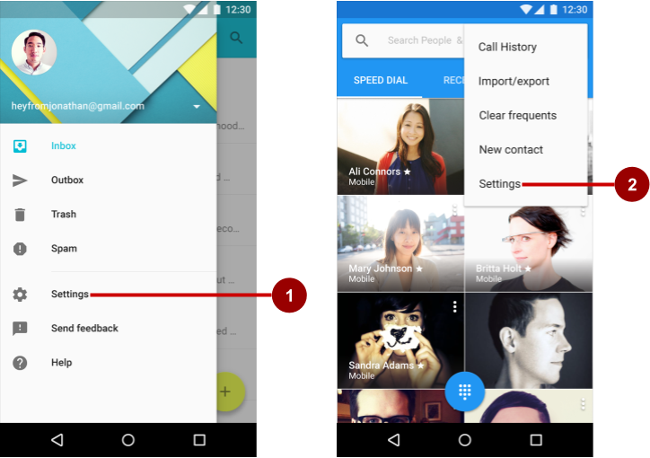
Accessing settings
Users access settings through:
Navigation drawer
Options menu

Slide 8
Setting screens

Slide 9
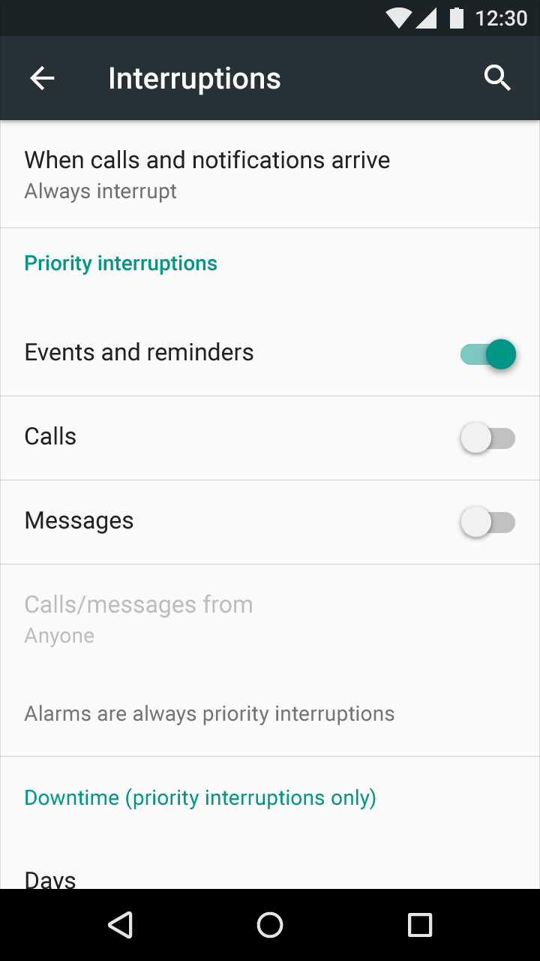
Organize your settings
Predictable, manageable number of options
7 or less: arrange according to priority with most important at top
7-15 settings: group related settings under section dividers

Slide 10
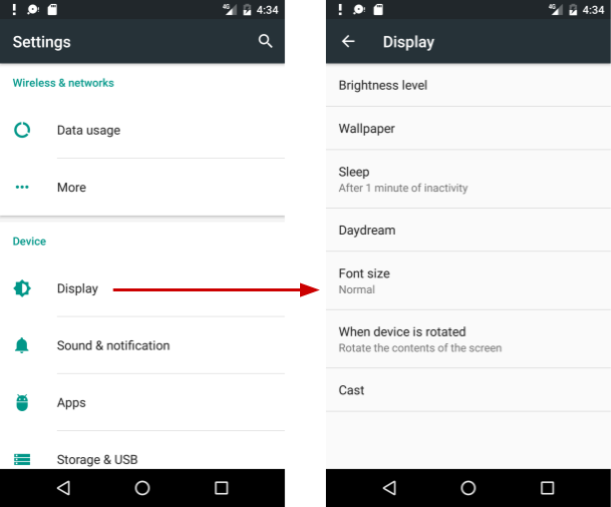
16+ Settings
Group into sub-screens opened from main Settings screen

Slide 11
View versus Preference
Use Preference objects instead of View objects in your Settings screens
Design and edit Preference objects in the Layout editor just like you do for View objects

Slide 12
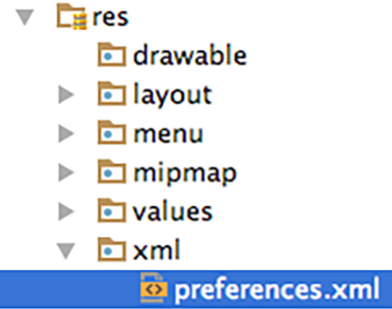
Define Settings in a Preference Screen
Define settings in a preferences screen
It is like a layout
define in:
res > xml > preferences.xml

Slide 13
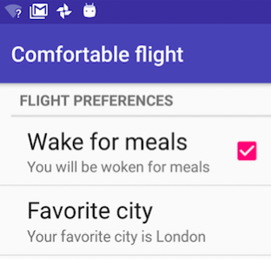
Preference Screen example
<PreferenceScreen> <PreferenceCategory android:title="Flight Preferences">
<CheckBoxPreference android:title="Wake for meals" ... />
<EditTextPreference android:title="Favorite city" .../>
</PreferenceCategory> </PreferenceScreen>

Slide 14

Every Preference must have a key
Every preference must have a key
Android uses the key to save the setting value
<EditTextPreference
android:title="Favorite city"
android:key="fav_city"
… />

Slide 15
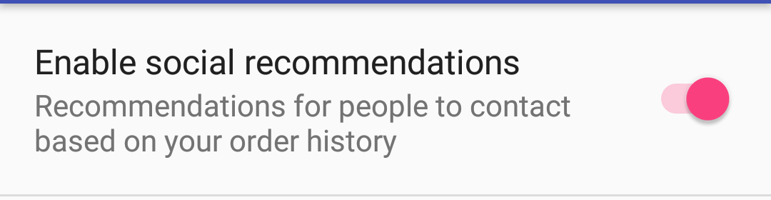
SwitchPreference
<?xml version="1.0" encoding="utf-8"?>
<PreferenceScreen xmlns:android="http://schemas.android.com/apk/res/android">
<SwitchPreference
android:defaultValue="true"
android:title="@string/pref_title_social"
android:key="switch"
android:summary="@string/pref_sum_social" />
</PreferenceScreen>

Slide 16
SwitchPreference attributes
android:defaultValue—true by default
android:summary—text underneath setting, for some settings, should change to reflect value
android:title—title/name
android:key—key for storing value in SharedPreferences

Slide 17
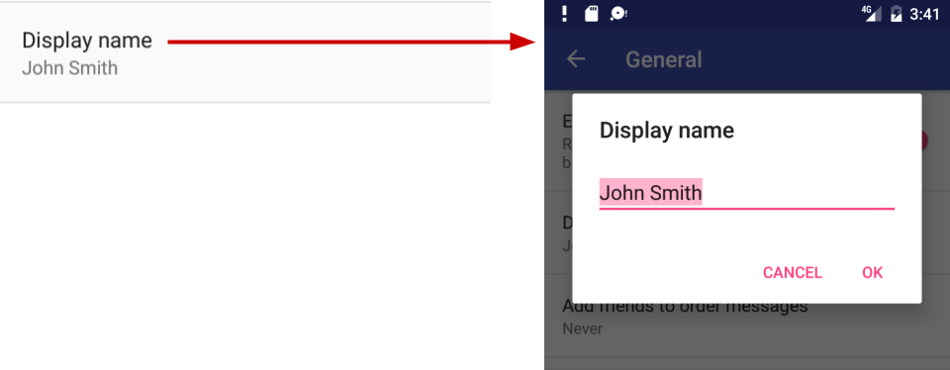
EditTextPreference
<EditTextPreference
android:capitalize="words"
android:inputType="textCapWords"
android:key="user_display_name"
android:maxLines="1"
android:defaultValue="@string/pref_default_display_name"
android:title="@string/pref_title_display_name" />

Slide 18
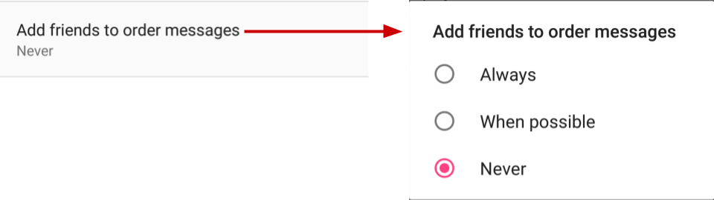
ListPreference
<ListPreference
android:defaultValue="-1"
android:key="add_friends_key"
android:entries="@array/pref_example_list_titles"
android:entryValues="@array/pref_example_list_values"
android:title="@string/pref_title_add_friends_to_messages" />

Slide 19
ListPreference
Default value of -1 for no choice
android:entries—Array of labels for radio buttons
android:entryValues —Array of values radio button

Slide 20
Preference class
Preference class provides View for each kind of setting
associates View with SharedPreferences interface to store/retrieve the preference data
Uses key in the Preference to store the setting value

Slide 21
Preference subclasses
CheckBoxPreference—list item that shows a checkbox
ListPreference—opens a dialog with a list of radio buttons
SwitchPreference—two-state toggleable option
EditTextPreference—that opens a dialog with an EditText
RingtonePreference—lets user to choose a ringtone

Slide 22
Classes for grouping
PreferenceScreen
root of a Preference layout hierarchy
at the top of each screen of settings
PreferenceGroup
for a group of settings (Preference objects).
PreferenceCategory
title above a group as a section divider

Slide 23
Implement settings

Slide 24
Settings UI uses fragments
Use an Activity with a Fragment to display the Settings screen
Use specialized Activity and Fragment subclasses that handle the work of saving settings

Slide 25
Activities and fragments for settings
Android 3.0 and newer:
AppCompatActivity with PreferenceFragmentCompat
OR use Activity with PreferenceFragment
Android older than 3.0 (API level 10 and lower):
build a special settings activity as an extension of the PreferenceActivity class (use the template!)
Lesson focusses on this!

Slide 26
Steps to implement Settings
For AppCompatActivity with PreferenceFragmentCompat:
Create the preferences screen
Create an activity for the settings
Create a fragment for the settings
Add the preferenceTheme to the AppTheme
Add code to invoke Settings UI

Slide 27
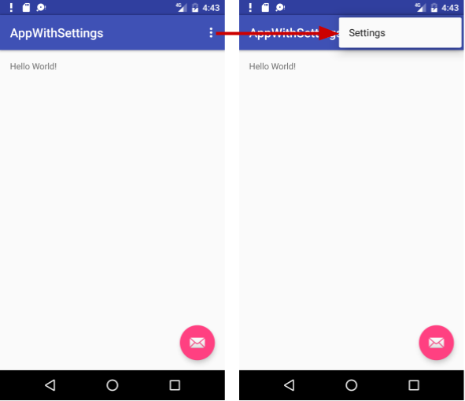
Basic Activity template
Basic Activity template Includes options menu
Settings menu item provided for options menu

Slide 28
Create a Settings Activity subclass
Extends AppCompatActivity
in onCreate() display the settings fragment:
getSupportFragmentManager()
.beginTransaction()
.replace(android.R.id.content,
new MySettingsFragment())
.commit();

Slide 29
Settings Activity example
public class MySettingsActivity extends AppCompatActivity {
@Override
protected void onCreate(Bundle savedInstanceState) {
super.onCreate(savedInstanceState);
getSupportFragmentManager().beginTransaction()
.replace(android.R.id.content, new MySettingsFragment())
.commit();
}
}
This is the whole class!

Slide 30
Create a Settings Fragment subclass
Extends PreferenceFragmentCompat
Implement methods:
onCreatePreferences() displays the settings
setOnPreferenceChangeListener() handles any changes that need to happen when the user changes a preference (optional)

Slide 31
PreferenceFragment
public class MySettingsFragment extends PreferenceFragmentCompat { …}
Blank fragments include onCreateView() by default
Replace onCreateView() with onCreatePreferences() because this fragment displays a preferences screen

Slide 32
Settings Fragment example
public class MySettingsFragment extends PreferenceFragmentCompat {
@Override
public void onCreatePreferences(Bundle savedInstanceState,
String rootKey) {
setPreferencesFromResource(R.xml.preferences, rootKey);
}
}

Slide 33
Add PreferenceTheme to app's theme
If using PreferenceFragmentCompat, set preferenceTheme in styles.xml:
<style name="AppTheme" parent="...">
...
<item name="preferenceTheme"> @style/PreferenceThemeOverlay
</item>
…
</style>

Slide 34
Invoke Settings UI
Send the Intent to start the Settings Activity:
From Options menu, update onOptionItemsSelected()
From Navigation drawer, update onItemClick() on the OnItemClickListener given to setOnItemClickListener

Slide 35
Default Settings

Slide 36
Default settings
Set default to value most users would choose
All contacts
Use less battery power
Bluetooth is off until the user turns it on
Least risk to security and data loss
Archive rather than delete messages
Interrupt only when important
When calls and notifications arrive

Slide 37
Set default values
Use android:defaultValue in Preference view in xml:
<EditTextPreference
android:defaultValue="London"
… />
In main activity's onCreate(), save default values.

Slide 38
Save default values in shared preferences
In onCreate() of MainActivity
PreferenceManager.setDefaultValues(
this, R.xml.preferences, false);
App context, such as this
Resource ID of XML resource file with settings
false only calls method the first time the app starts

Slide 39
Save and retrieve settings

Slide 40
Saving setting values
No need to write code to save settings!
If you use specialized Preference Activity and Fragment, Android automatically saves setting values in shared preferences

Slide 41
Get settings from shared preferences
In your code, get settings from default shared preferences
Use key as specified in preference view in xml
SharedPreferences sharedPref = PreferenceManager.getDefaultSharedPreferences(this);
String destinationPref = sharedPref.getString("fav_city", "Jamaica");

Slide 42
Get settings values from shared preferences
In preference definition in xml:
<EditTextPreference
android:defaultValue="London"
android:key="fav_city" />
In code, get fav_city setting:
String destinationPref = sharedPref.getString("fav_city", "Jamaica");
default setting value
is different than
default value returned by pref.getString() if key is not found in shared prefs

Slide 43
Respond to changes in settings

Slide 44
Listening to changes
Display related follow-up settings
Disable or enable related settings
Change the summary to reflect current choice
Act on the setting
for example, if the setting changes the screen background, then change the background

Slide 45
Listen for changes to settings
Define setOnPreferenceChangeListener()
in onCreate() in the Settings Fragment

Slide 46
onCreatePreferences() example
@Override
public void onCreatePreferences(Bundle savedInstanceState,
String rootKey) {
setPreferencesFromResource(R.xml.preferences, rootKey);
ListPreference colorPref = (ListPreference) findPreference("color_pref");
colorPref.setOnPreferenceChangeListener(
// see next slide
// ...);
}

Slide 47
onPreferenceChangeListener() example
Example: change background color when setting changes
colorPref.setOnPreferenceChangeListener(
new Preference.OnPreferenceChangeListener(){
@Override
public boolean onPreferenceChange(
Preference preference, Object newValue){
setMyBackgroundColor(newValue);
return true;
}
});

Slide 48
Summaries for settings

Slide 49
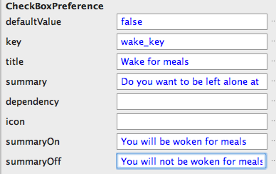

Summaries for true/false values
Set attributes to define conditional summaries for preferences that have true/false values

Slide 50
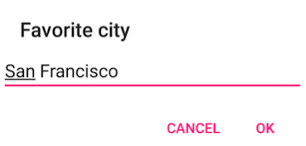

Summaries for other settings
For settings that have values other than true/false, update the summary when the setting value changes
Set the summary in onPreferenceChangeListener()

Slide 51
Set summary example
EditTextPreference cityPref = (EditTextPreference)
findPreference("fav_city");
cityPref.setOnPreferenceChangeListener(
new Preference.OnPreferenceChangeListener(){
@Override
public boolean onPreferenceChange(Preference pref, Object value){
String city = value.toString();
pref.setSummary("Your favorite city is " + city);
return true;
}
});

Slide 52
Activity Template

Slide 53
More complex?
For anything more complex
?
use the SettingsActivity template!

Slide 54
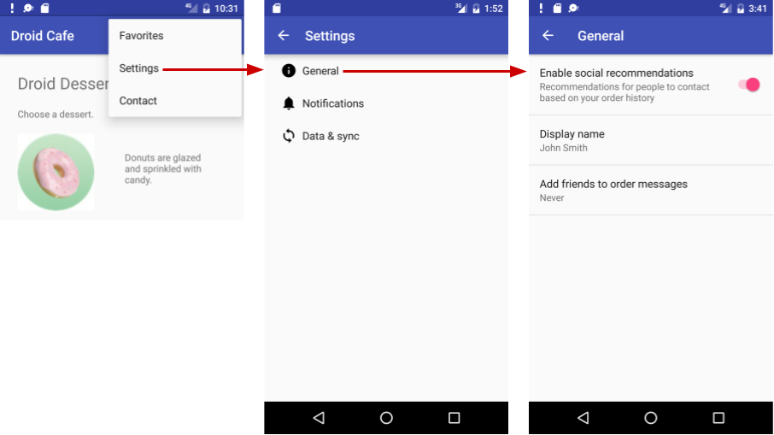
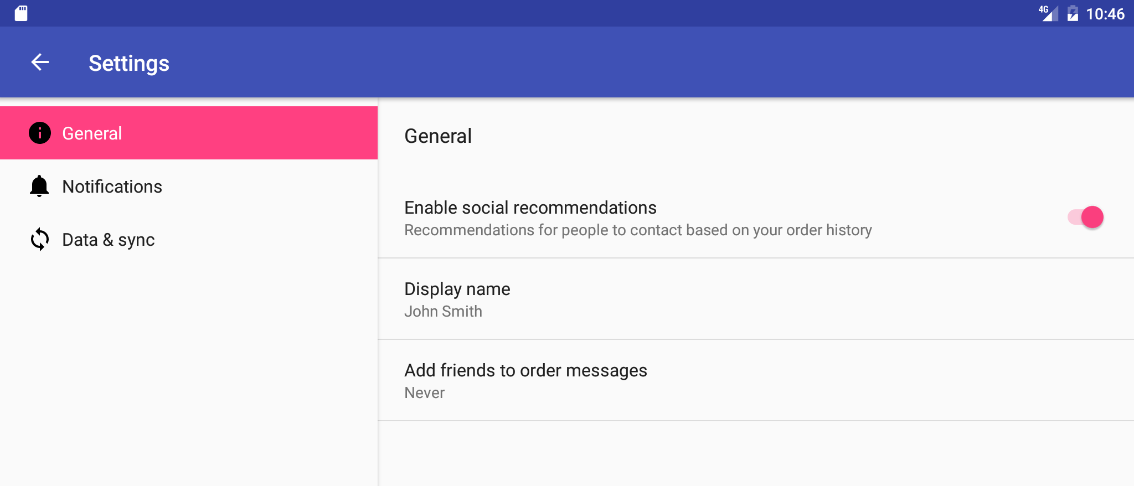
Settings Activity template
Complex Settings
Backwards compatibility
Customize pre-populated settings
Adaptive layout for phones and tablets
Phone
Tablet

Slide 55
Learn more

Slide 56
Learn more
Android Studio User Guide
Settings (coding)
Preference class
PreferenceFragment
Fragment
SharedPreferences
Saving Key-Value Sets
Settings (design)

Slide 57
What's Next?
Concept Chapter: 9.2 C App Settings
Practical: 9.2 P Adding Settings to an App

Slide 58
END

